Slide 1
Physiology of hearing and Equilibrium

Slide 2
Physiology of hearing
Sound: Compression and rarefaction of the air molecules
Intensity- loudness (amplitude)- decibel
Frequency- Pitch- hertz (CPS)
Quality- Timbre- overtones of basic frequency

Slide 3
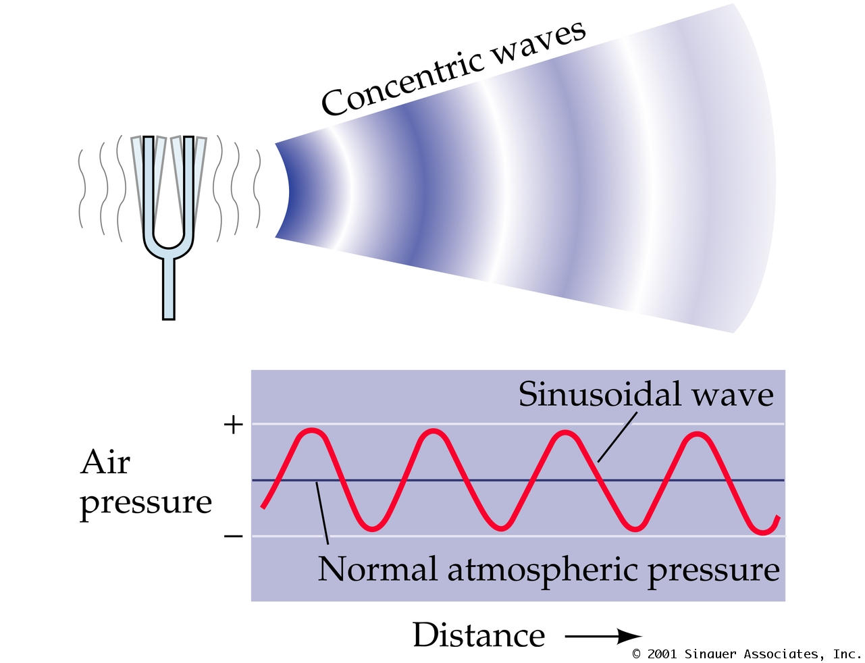
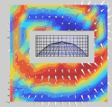

Slide 4
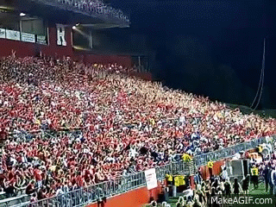

Slide 5
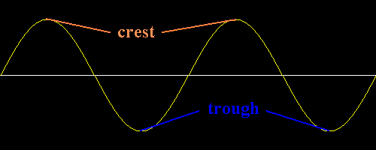
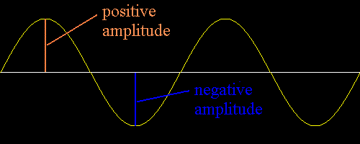
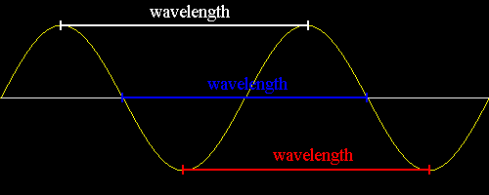
Sound characteristics

Slide 7
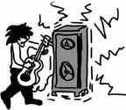
Audible frequency: 20-20,000 hertz (<20: subsonic, >20,000: ultrasonic)
Speech frequency: 500-3000 hertz
Pure tone: single frequency sound
Noise: mixture of multiple frequencies- irregular and not orderly (non-harmonic)
Music: mixture of multiple frequencies- regular and orderly- (harmonic)
Speech: sentences-words-alphabets-made up of multiple frequencies

Slide 8
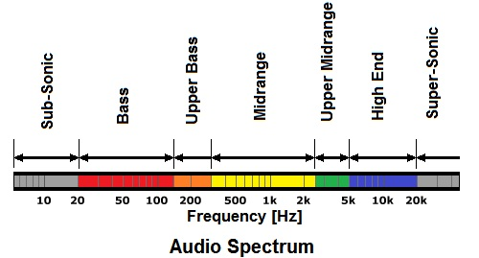
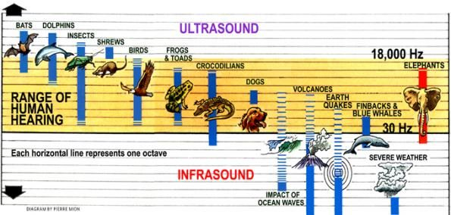

Slide 9
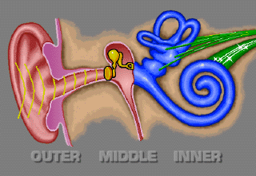
Parts of the ear
Conductive apparatus
Conducts mechanical sound impulse to the inner ear
External and middle ear
Perceptive apparatus
Converts mechanical sound impulse into electrical impulse and transmits to higher centers
Cochlea

Slide 10
Role of external ear
Collection of sound waves by pinna
Conduction of waves to the tympanic membrane
Resonance of frequency around 4000 hertz

Slide 11
resonance
Natural ability of a structure to vibrate easily at a noted frequency
Damping at other frequencies
“allows/ transmits” resonant frequencies best

Slide 12
Role of middle ear in hearing
Impedance matching mechanism (transformer or amplifier function)
Preferential sound pressure application
Resonance of sound frequency around 2000 hertz
Equalization of pressure on either sides of the tympanic membrane (Eustachian tube)

Slide 13
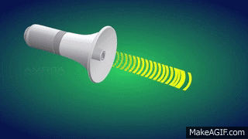
impedance
Resistance to travel of sound
Especially at change of media

Slide 14
Impedance matching mechanism
Impedance matching: When sound travels from air to fluids, amplitude is reduced as fluid offers impedance
Similar situation in the ear: Middle ear to cochlear fluids
Need to compensate for the loss thus occurred
Middle ear amplifies the sound intensity to match for the above loss

Slide 15
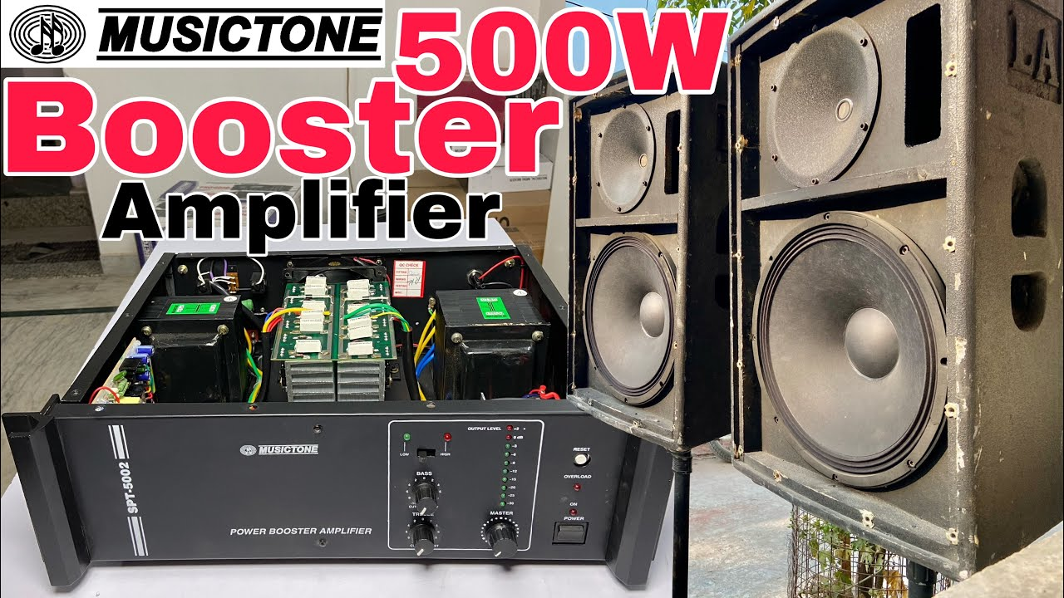
How does middle ear act as an amplifier?
Surface area ratio (Hydraulic ratio)
Tympanic membrane: 55 sq mm
Stapes foot plate: 3.2 sq mm
Mechanical advantage: 17 times
Lever ratio
Length of handle of malleus versus long process of incus- 1.3:1
Total Mechanical advantage: 17X1.3= 22
Buckling action of the tympanic membrane

Slide 16
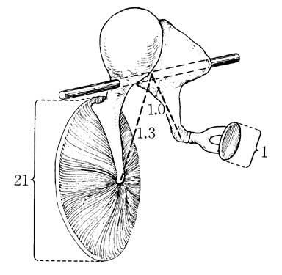
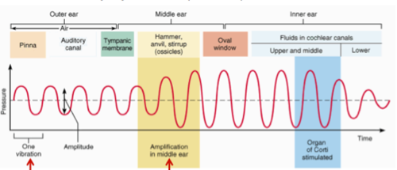

Slide 17
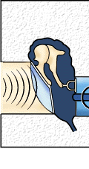
Preferential sound pressure application
Round window protection
Sound pressure applied to oval window
Cochlear fluids moves from scala vestibuli to scala tympani
Round window membrane yields
Large TM perforation- loss of this function

Slide 18
Role of inner ear- Hydrodynamics
Converts mechanical sound impulse into electrical sound impulse
Sound pressure travels from scala vestibuli- helicotrema- scala tympani- RW membrane yields
Scala media moves up and down

Slide 19
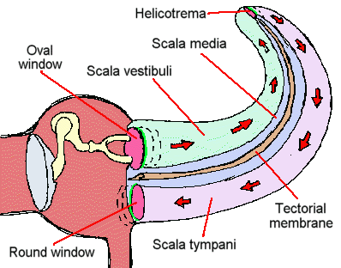

Slide 20
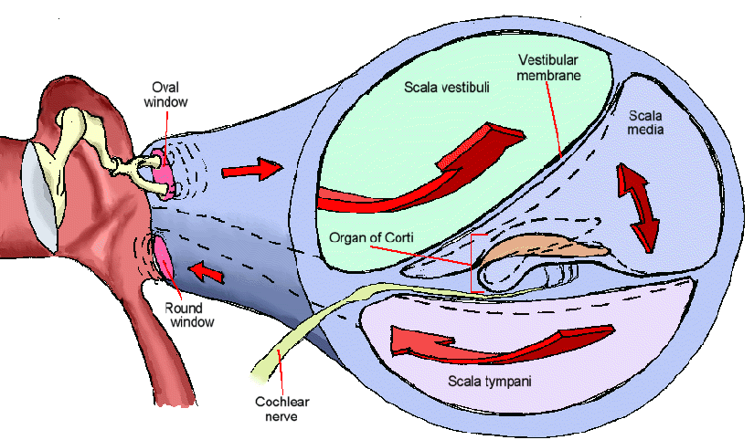

Slide 21
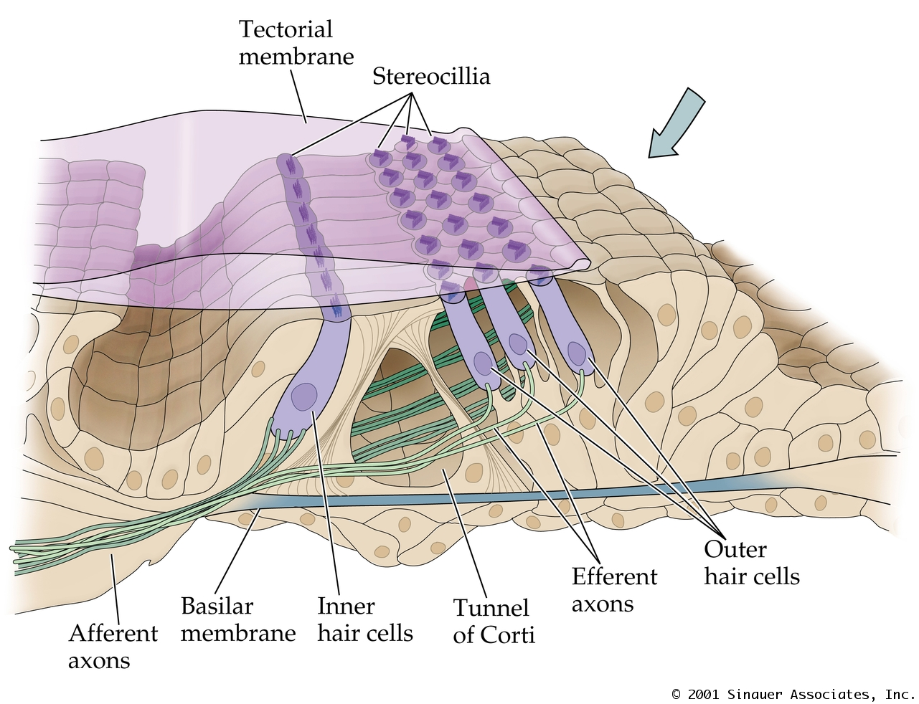

Slide 22
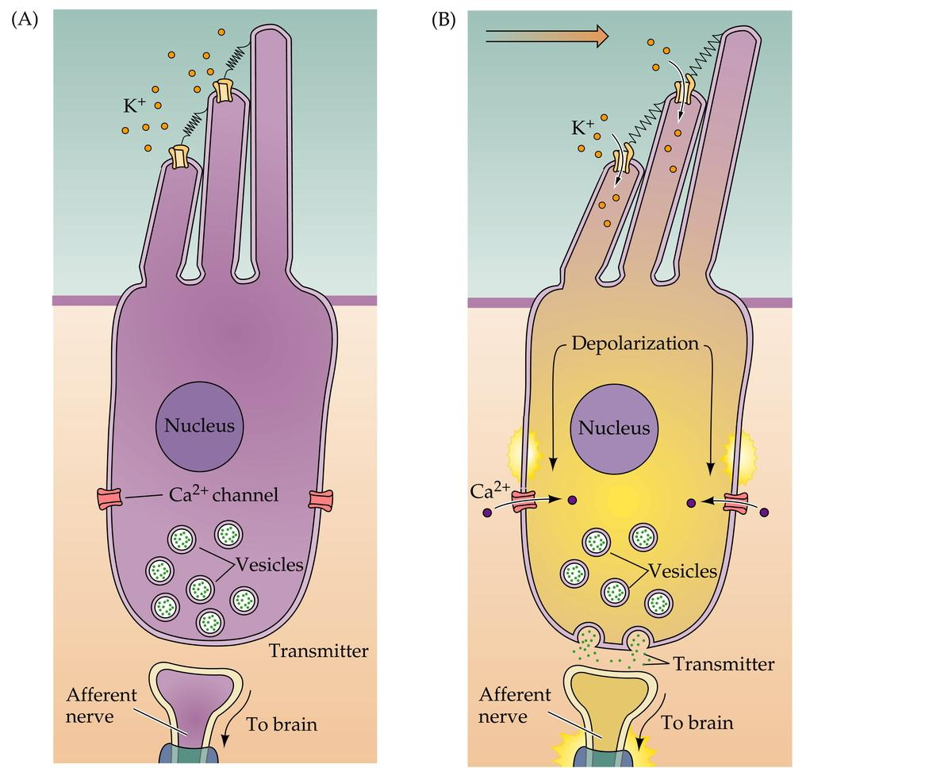

Slide 23
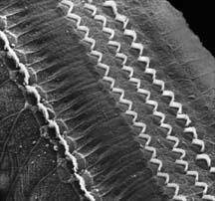
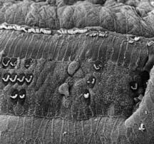
Hair cells
Normal
Damaged

Slide 24
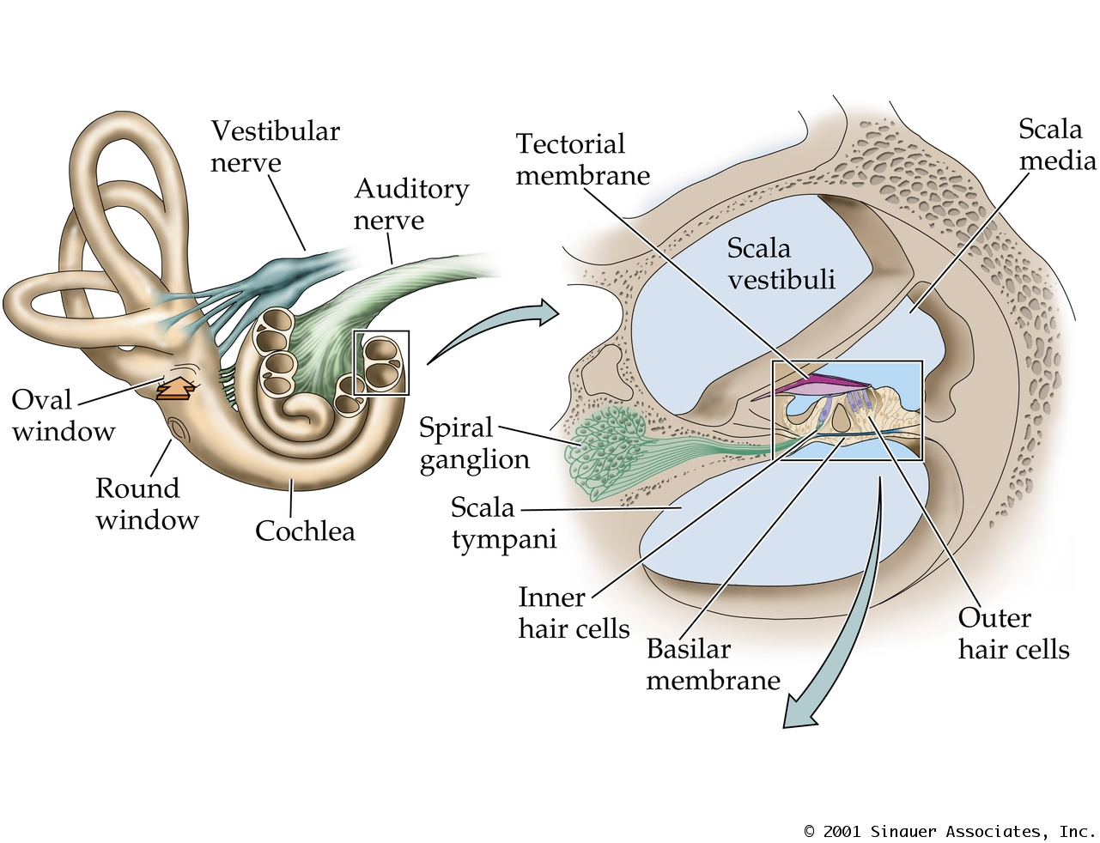

Slide 25
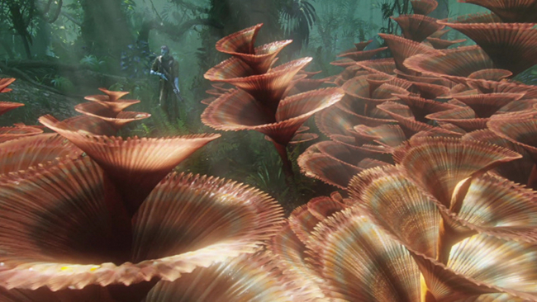

Slide 26
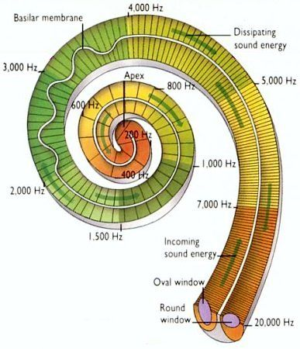
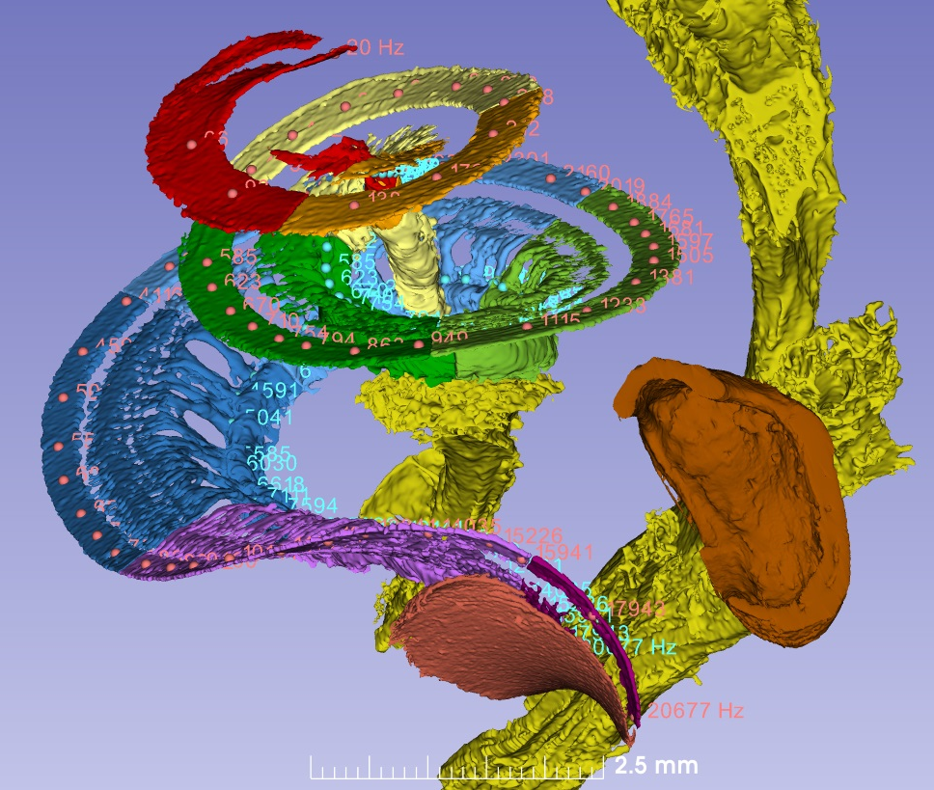

Slide 27
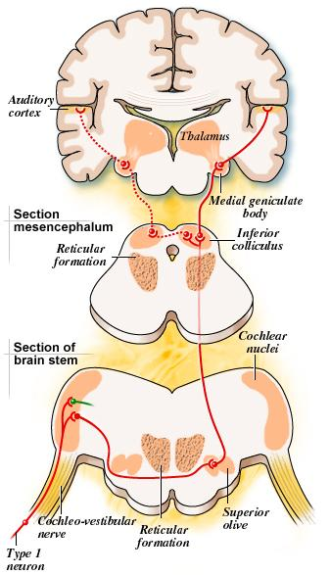
Auditory pathway
ACS LIMA
Auditory nerve
Cochlear nucleus
Superior olive nucleus
Lateral lemniscus
Inferior colliculus
Medial geniculate body
Auditory cortex

Slide 29
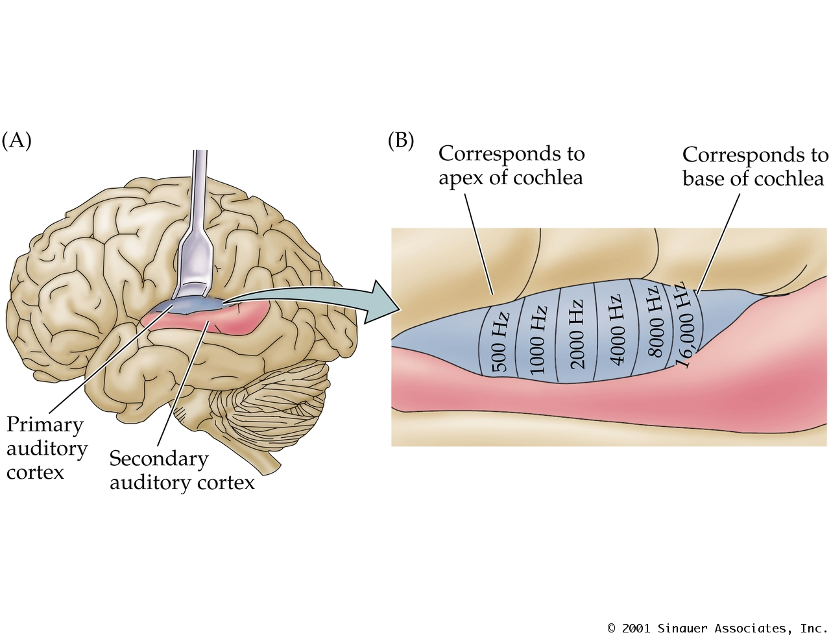

Slide 30
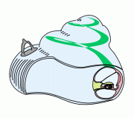
Theories of hearing
Describes the mode of pitch differentiation by the cochlea
Necessary for speech discrimination
3 theories
Helmholtz ‘Place’ theory
Rutherford’s ‘telephone’ theory
Wever’s ‘volley’ theory

Slide 31
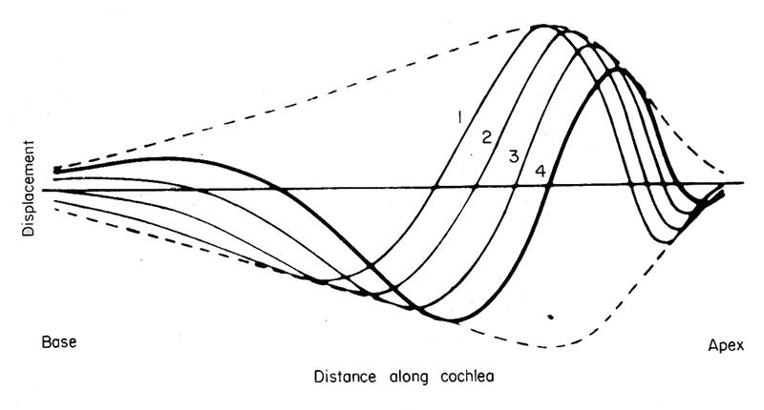
Von-Bekesy’s traveling wave

Slide 32
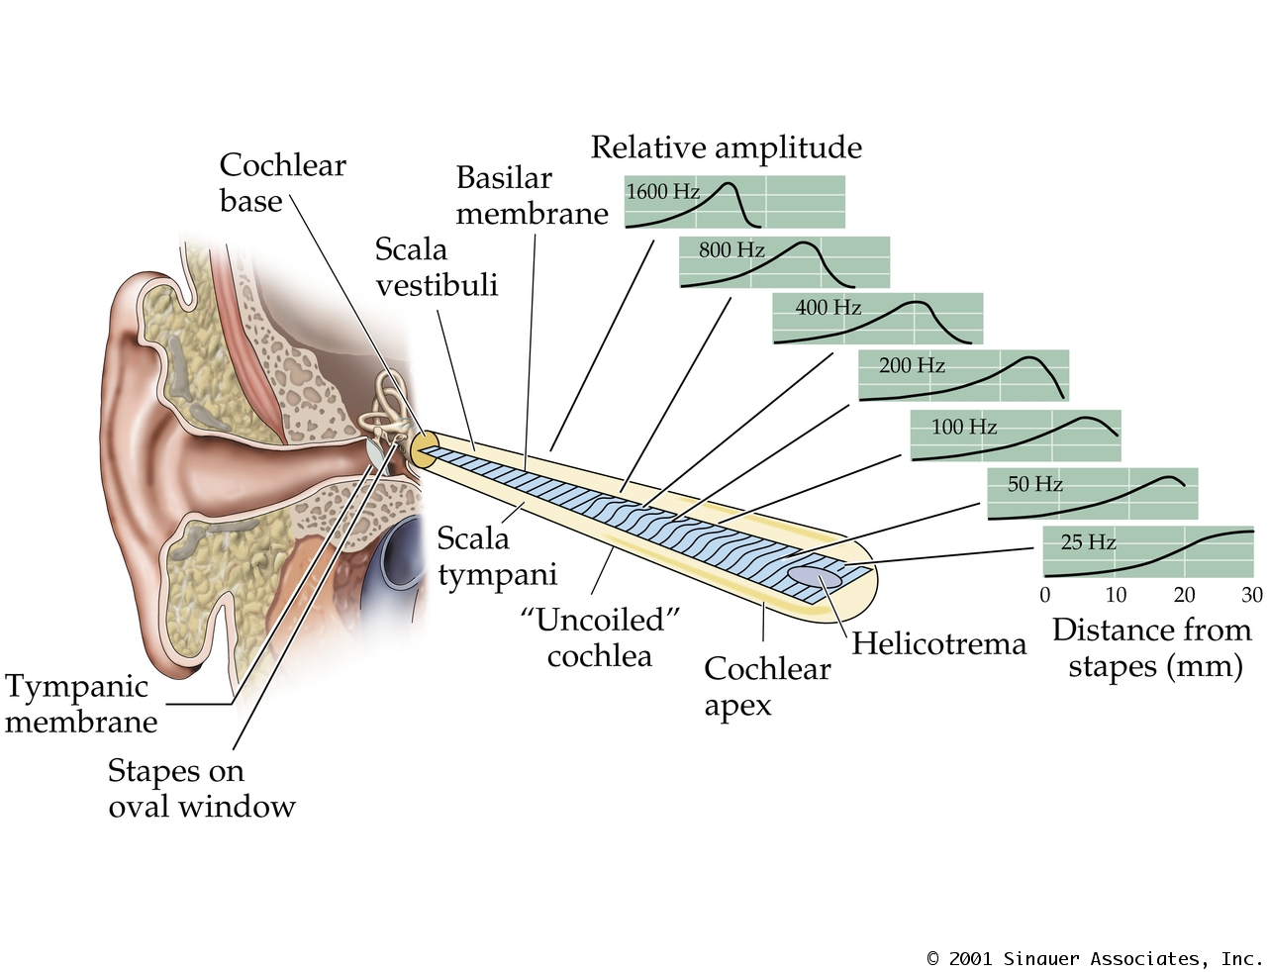

Slide 33
Physiology of equilibrium
Balance of the various parts of the body during static or dynamic positions are maintained by 4 organs
Vestibular apparatus (inner ear)
Eye
Posterior column of the spinal cord
Cerebellum

Slide 34
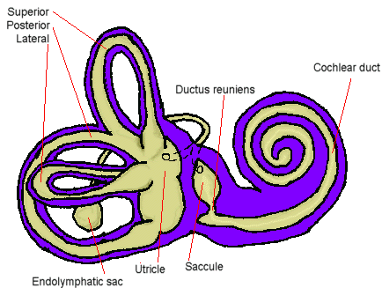
Vestibular apparatus
Vestibular apparatus of the 2 sides act as one unit
Vestibular fluids move with head movements
Detects head position and movements needed for postural adjustments
Head movements can be
Angular acceleration
Semicircular canals: Cristae
Linear acceleration
Utricle and saccule: Maculae

Slide 35
Balance funtion-interesting facts
Always working unconsciously
Signal storage and reset- infinite capability
Governs posture of body, head movements
vision correction during movement
automatic body reflexes to prevent falls
Learning & memory

Slide 36
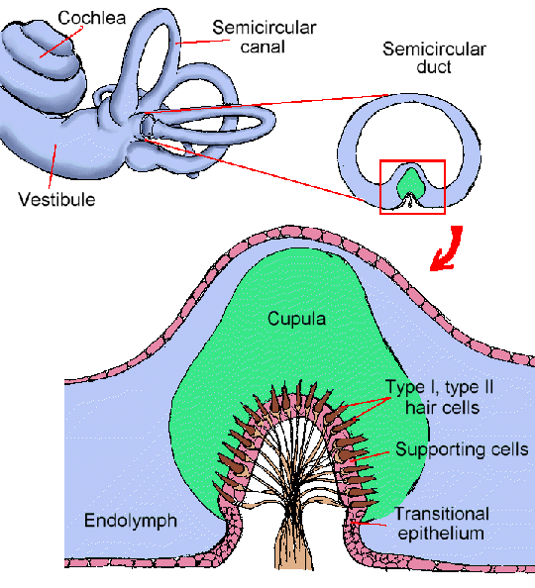

Slide 37
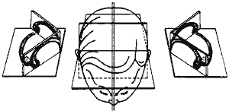
Arrangement of semicircular canals

Slide 38
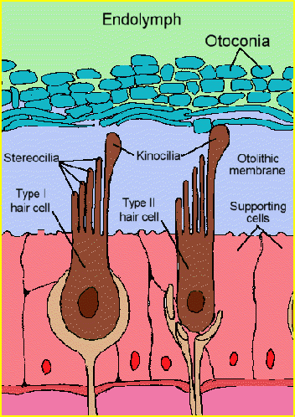
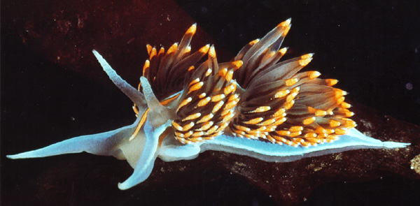
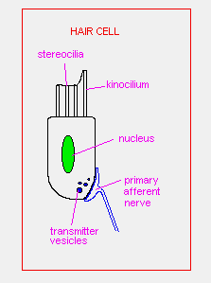

Slide 40
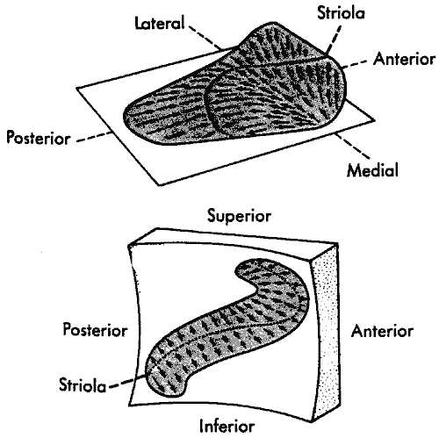
Maculae

Slide 42
Thank you

